Slide 1
CS5112: Algorithms and Data Structures for Applications
Reductions, lower bounds, hashing
Ramin Zabih
Some content from: Wikipedia;
J. Leskovec, A. Rajaraman, J. Ullman: Mining of Massive Datasets, http://www.mmds.org

Slide 2
Administrivia
Class average on the duck problem (reductions) was by far the lowest on the prelim
This is core CS material
Dynamic programming, NP completeness, hashing
The other hard problem (MST) was not core
A duck problem will be on the final exam
Today we’re going to go over this again
Bring your questions!

Slide 3
Lecture outline
Reductions to prove hardness
Lower bounds
Example problems
Universal and perfect hashing
String search with hashing
Distributed hash tables

Slide 4
Reduction key ideas
Turning one problem into another is incredibly powerful
Often to make a problem easy
PageRank, intelligent scissors, etc.
Most of the ‘greatest hits’ in CS
Sometimes to show a problem is hard
NP-hardness or lower bounds
Utility is not quite as obvious but it’s still important

Slide 5
Traveling Salesman Problem
Given a list of cities and the distances between each pair of cities, what is the shortest possible route that visits each city and returns to the origin city?
The decision version is whether there exists a route whose total distance is no greater than L.
Seems awfully similar to Hamiltonian cycle
They’re both graph problems
They’re both looking for cycles
Biggest difference seems to be the edge weights
Idea: we know Hamiltonian cycle is NP-complete. If we can reduce Hamiltonian cycle to Traveling Salesman Problem, we’ll know TSP is NP-complete as well.
Intuitively: we know Hamiltonian cycle is hard. If it’s easy to take the solution to TSP and determine a solution for Hamiltonian, that must mean TSP is hard too.

Slide 6
Example reduction
Suppose we can efficiently solve the duck problem by using the rabbit problem as our key subroutine
What follows from this?
What if we knew that the duck problem was NP hard?
What if we knew that the duck problem could not be solved in polynomial time?
Notes:
Informally: if the rabbit problem were easy (tractable), so is the duck problem
More precisely, rabbit in P implies duck in P
BUT NOT THE OTHER WAY AROUND
Duck NP-hard => R NP-hard
Duck not in P => R not in P
[What we actually know is that R is at least as hard as D]

Slide 7
Going in the other direction
Suppose we knew that there was a polynomial time duck problem algorithm.
We cam do this if we had a polynomial time rabbit algorithm
What does this tell us about the rabbit problem?
Can you write a sorting algorithm that calls SAT? Or TSP?
Notes:
Answer: tells us nothing
If you can solve D efficiently using R that only tells you that D hard => R hard
D easy does not imply R easy

Slide 8
Example problems (reductions)
Assume rabbit is in P. Show duck is in P.
Assume rabbit is NP-hard. Show duck is NP-hard.
Assume rabbit is NP-complete. Show duck is NP-complete.
Notes:
Show that you can solve D by calling R polynomially many times
Show that you can solve R efficiently by solving D
As above, but also show that you can very a solution to D in polynomial time

Slide 9
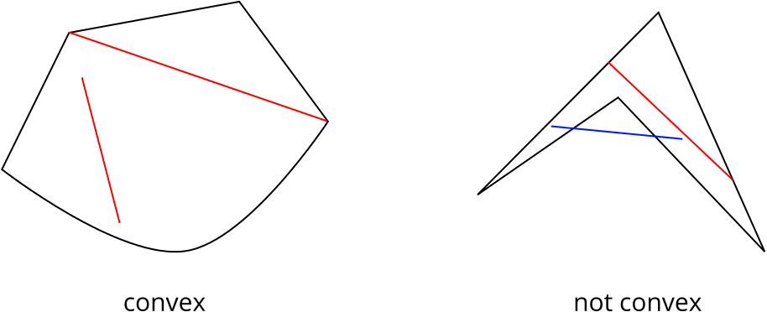
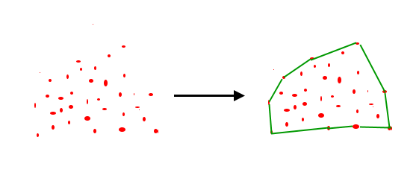
Convex hull problem
Figure source
Figure source

Slide 10
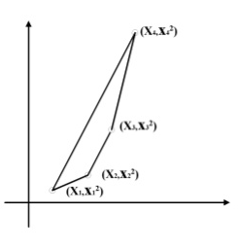
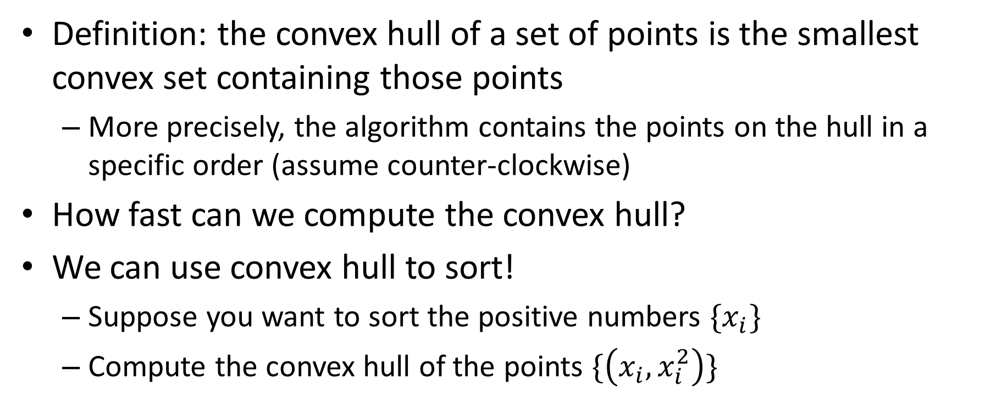
Convex hull lower bound
Definition: the convex hull of a set of points is the smallest convex set containing those points
More precisely, the algorithm contains the points on the hull in a specific order (assume counter-clockwise)
How fast can we compute the convex hull?
We can use convex hull to sort!
Suppose you want to sort the positive numbers $\{x_{i}\}$
Compute the convex hull of the points $\{\left(x_{i}, x_{i}^{2}\right)\}$
Figure source

Slide 11
Example problems (lower bounds)
In the following, what do we know about the duck problem’s lower bound, if anything?
Duck1 can efficiently solve sorting.
Sorting can be used to solve duck2.
Duck3 is solvable in polynomial time.
Duck4 is solvable in exponential time.
Duck5 is NP-hard.
Notes:
O(n log n) lower bound
Nothing
Nothing
Nothing
Nothing, really

Slide 12
Universal and perfect hashing
Back to hashing
We talked about perfect hashing (no collisions)
Minimal: table is exactly full
Main application is with fixed input data
Example: compilers
How do we generate perfect hash functions for our data?
Give up on minimality

Slide 13
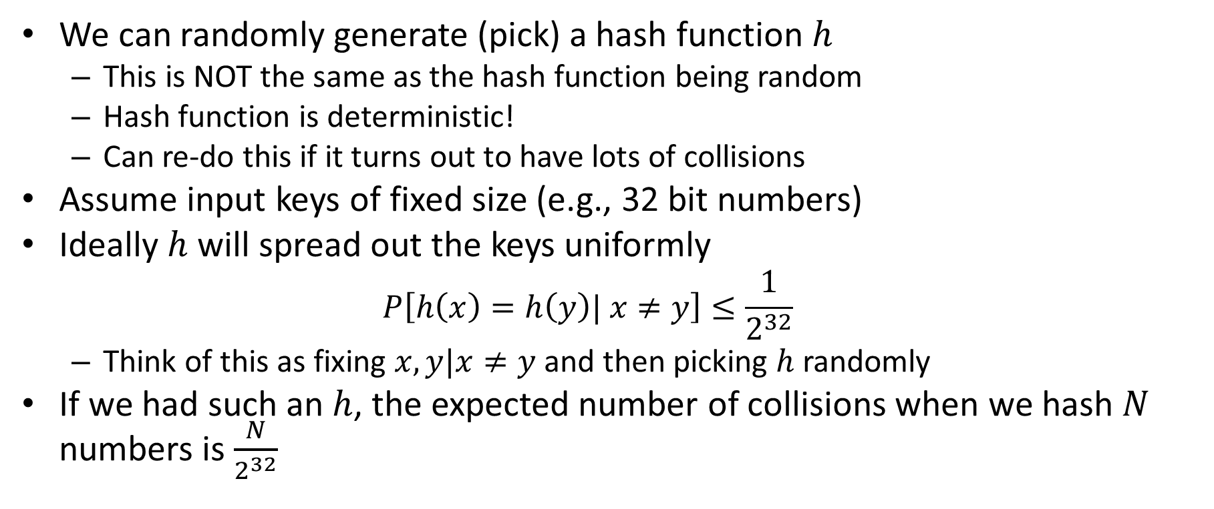
Universal hashing
We can randomly generate (pick) a hash function $h$
This is NOT the same as the hash function being random
Hash function is deterministic!
Can re-do this if it turns out to have lots of collisions
Assume input keys of fixed size (e.g., 32 bit numbers)
Ideally $h$ will spread out the keys uniformly
$$P\left[h\left(x\right)=h\left(y\right)| x≠y\right]≤\frac{1}{2^{32}}$$
Think of this as fixing $x,y|x≠y$and then picking $h$randomly
If we had such an $h$, the expected number of collisions when we hash $N$ numbers is $\frac{N}{2^{32}}$

Slide 14
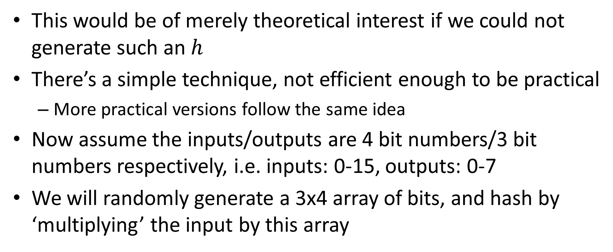
Universal hashing by matrix multiplication
This would be of merely theoretical interest if we could not generate such an $h$
There’s a simple technique, not efficient enough to be practical
More practical versions follow the same idea
Now assume the inputs/outputs are 4 bit numbers/3 bit numbers respectively, i.e. inputs: 0-15, outputs: 0-7
We will randomly generate a 3x4 array of bits, and hash by ‘multiplying’ the input by this array

Slide 15
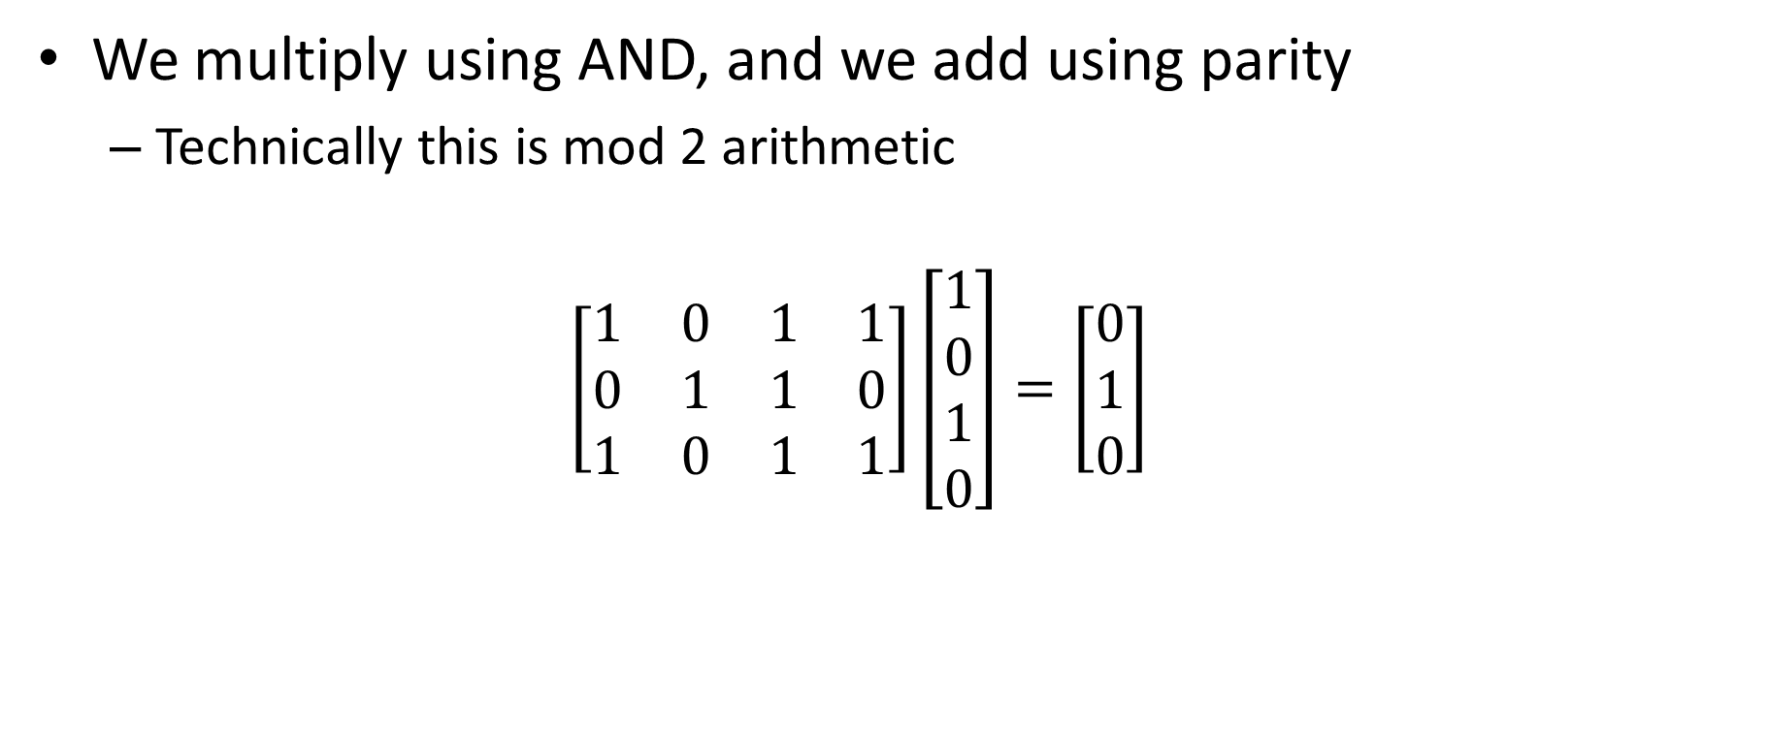
Universal hashing example
We multiply using AND, and we add using parity
Technically this is mod 2 arithmetic
$$\left[\begin{matrix}1 & 0 & 1 & 1 \\ 0 & 1 & 1 & 0 \\ 1 & 0 & 1 & 1\end{matrix}\right]\left[\begin{matrix}1 \\ 0 \\ 1 \\ 0\end{matrix}\right]=\left[\begin{matrix}0 \\ 1 \\ 0\end{matrix}\right]$$

Slide 16
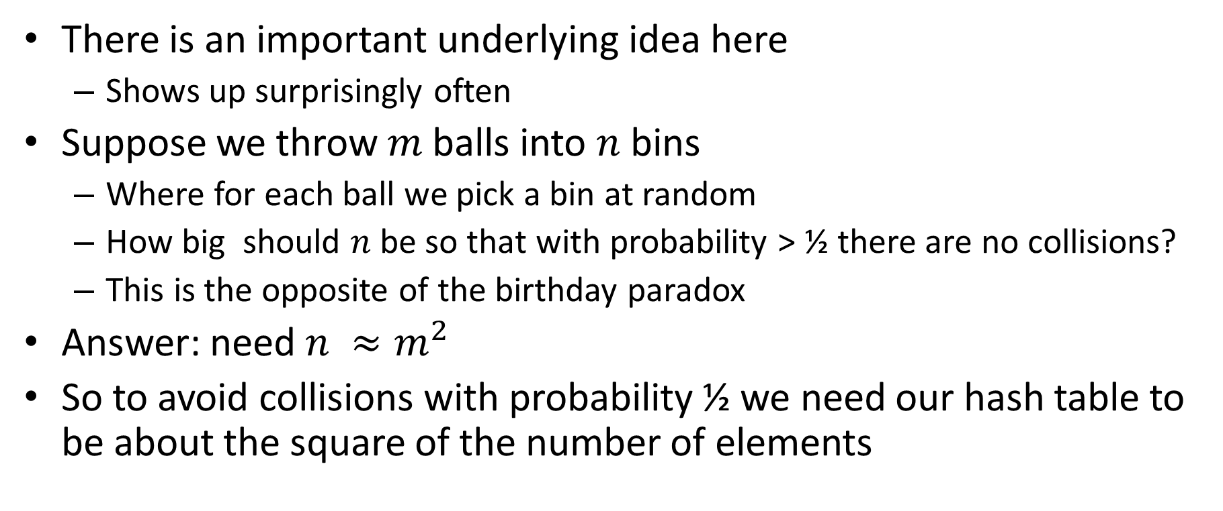
Balls into bins
There is an important underlying idea here
Shows up surprisingly often
Suppose we throw $m$balls into $n$ bins
Where for each ball we pick a bin at random
How big should $n$be so that with probability > ½ there are no collisions?
This is the opposite of the birthday paradox
Answer: need $n ≈m^{2}$
So to avoid collisions with probability ½ we need our hash table to be about the square of the number of elements

Slide 17
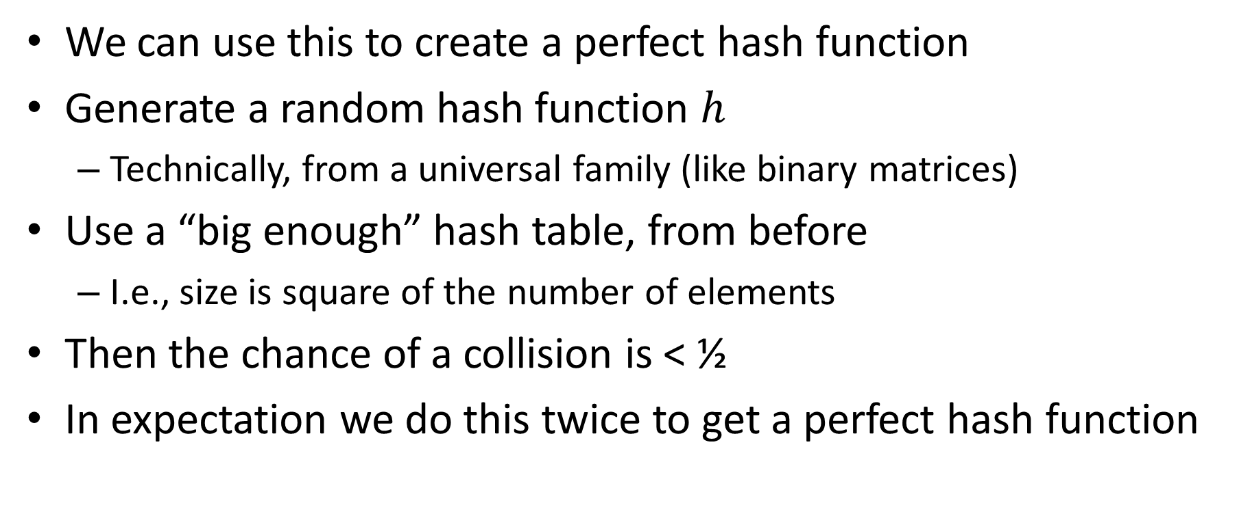
Perfect hashing from universal hashing
We can use this to create a perfect hash function
Generate a random hash function $h$
Technically, from a universal family (like binary matrices)
Use a “big enough” hash table, from before
I.e., size is square of the number of elements
Then the chance of a collision is < ½
In expectation we do this twice to get a perfect hash function

